Slide 1
DEEP LEARNING AND APPLICATIONS MR20-1CS0158
UNIT II
Tensor Flow: Computational Graph, Key highlights, Creating a Graph, Regression example, Gradient Descent, Tensor Board, Modularity, Sharing Variables, Keras Perceptrons: What is a Perceptron, XOR Gate.
Activation Functions: Sigmoid, ReLU, Hyperbolic Fns, Softmax
Text Book
1. Goodfellow, I., Bengio, Y., and Courville, A., Deep Learning, MIT Press, 2016

Slide 2

TensorFlow :
TensorFlow is an open-source machine learning and deep learninglibrary developed by Google.
TensorFlow is used to build and train deep learning models as it facilitates the creation of
computational graphs and efficient execution on various hardware platforms.
TensorFlow can train and run the deep neural networks for image recognition, handwritten digit classification, recurrent neural network, word embedding, natural language processing, video detection, and many more.
TensorFlow is run on multiple CPUs or GPUs and also mobile operating systems. The word TensorFlow is made by two words, i.e., Tensor and Flow
Components of TensorFlow
Tensor is a multidimensional array
Flow is used to define the flow of data in operation.

Slide 3
TensorFlow is basically a software library for numerical computation using data flow graphs where:
The chart gathers and describes all the computations done during the training.
nodes in the graph represent mathematical operations.
edges in the graph represent the multidimensional data arrays (called tensors) communicated between them. (Please note that tensor is the central unit of data in TensorFlow)
Installation Command:
pip install tensorflow
Advantages of Tensorflow:
It was fixed to run on multiple CPUs or GPUs and mobile operating systems.
The portability of the graph allows to conserve the computations for current or later use. The graph can be saved because it can be executed in the future.
All the computation in the graph is done by connecting tensors together.

Slide 4
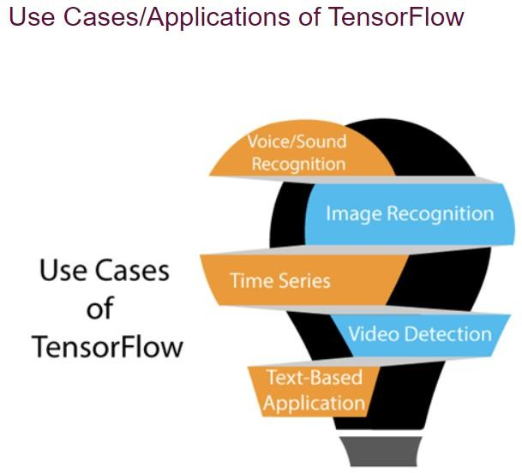
It is mainly used for deep learning or machine learning problems such
as Classification, Perception, Understanding, Discovering Prediction, and Creation.

Slide 5
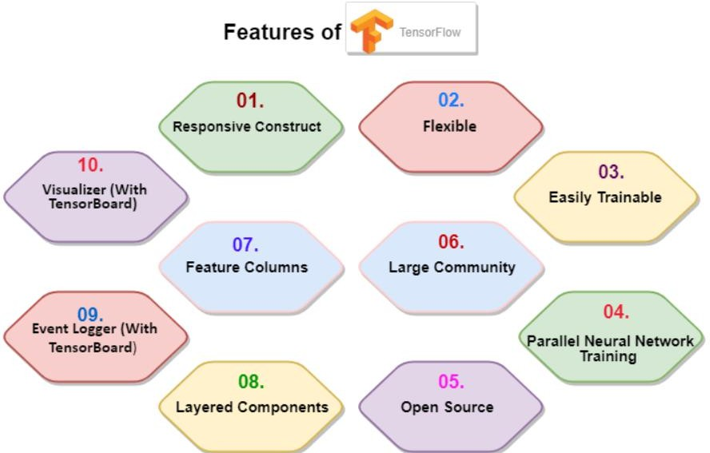
Features of TensorFlow
TensorFlow has an interactive multiplatform programming interface which is scalable and reliable
compared to other deep learning libraries which are available.
These features of TensorFlow will tell us about the popularity of TensorFlow.

Slide 6
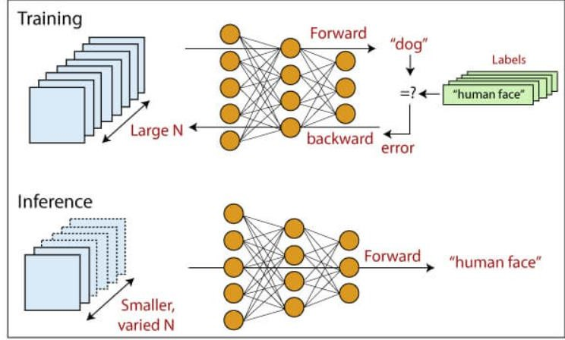
Responsive Construct
We can visualize each part of the graph, which is not an option while using Numpy or SciKit. To develop a deep learning application, firstly, there are two or three components that are required to create a deep learning application and need a programming language.
Flexible
It is one of the essential TensorFlow Features according to its operability. It has modularity and parts of it which we want to make standalone.
Easily Trainable
It is easily trainable on CPU and for GPU in distributed computing.
Parallel Neural Network Training
TensorFlow offers to the pipeline in the sense that we can train multiple neural networks and various GPUs, which makes the models very efficient on large-scale systems.

Slide 7
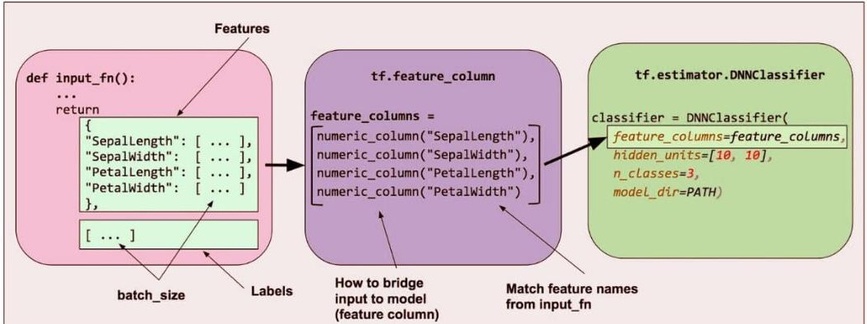
Large Community
Google has developed it, and there already is a large team of software engineers who work on stability improvements
continuously.
Open Source
The best thing about the machine learning library is that it is open source so anyone can use it as much as they have internet connectivity. So, people can manipulate the library and come up with a fantastic variety of useful products. And it has become another DIY community which has a massive forum for people getting started with it and those who find it hard to use it.
Feature Columns
TensorFlow has feature columns which could be thought of as intermediates between raw data and estimators; accordingly, bridging input data with our model.
The feature below describes how the feature column is implemented.

Slide 8
Availability of Statistical Distributions
This library provides distributions functions including Bernoulli, Beta, Chi2, Uniform, Gamma, which are essential,
especially where considering probabilistic approaches such as Bayesian models.
Layered Components
TensorFlow produces layered operations of weight and biases from the function such as tf.contrib.layers and also provides batch normalization, convolution layer, and dropout layer. So tf.contrib.layers.optimizers have optimizers such as Adagrad, SGD, Momentum which are often used to solve optimization problems for numerical analysis.
Visualizer (With TensorBoard)
We can inspect a different representation of a model and make the changed necessary while debugging it with the help of
TensorBoard.
Event Logger (With TensorBoard)
It is just like UNIX, where we use tail - f to monitor the output of tasks at the cmd. It checks, logging events and summaries from the graph and production with the TensorBoard.

Slide 9
Computational Graphs

Slide 10
Computational Graph
Any TensorFlow Core program can be divided into two discrete sections:
1.Building the computational graph.
A computational graph is nothing but a series of TensorFlow operations arranged into a graph of nodes.
Running the computational graph.
To actually evaluate the nodes, we must run the computational graph within a session.
A session encapsulates the control and state of the TensorFlow runtime.

Slide 11
Computational Graph
A computational graph is a fundamental concept in many deep learning frameworks, including TensorFlow and PyTorch. It is a graphical representation of a mathematical computation that consists of nodes and edges
Components of a Computational Graph:
Nodes (Vertices): Nodes represent operations or computations. These operations can be mathematical functions, such as addition or matrix multiplication, or more complex operations like convolution in a neural network. Each node takes one or more inputs, performs a specific operation, and produces an output.
Edges (Directed Edges): Edges represent the flow of data between nodes. They indicate the input-output relationships between operations. Data, in the form of tensors (multi- dimensional arrays), flows through these edges as it moves from one node to another.

Slide 12
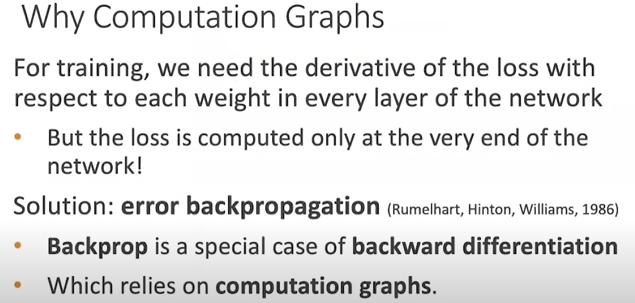
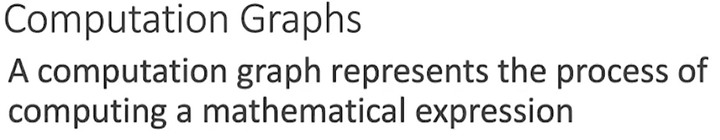
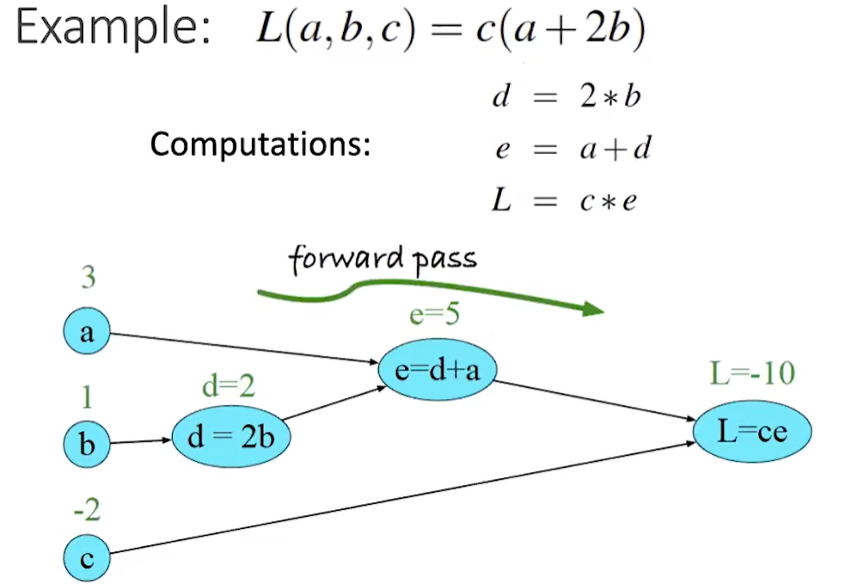
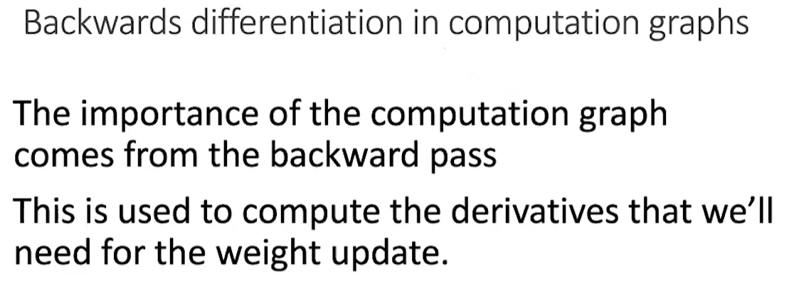

Slide 13
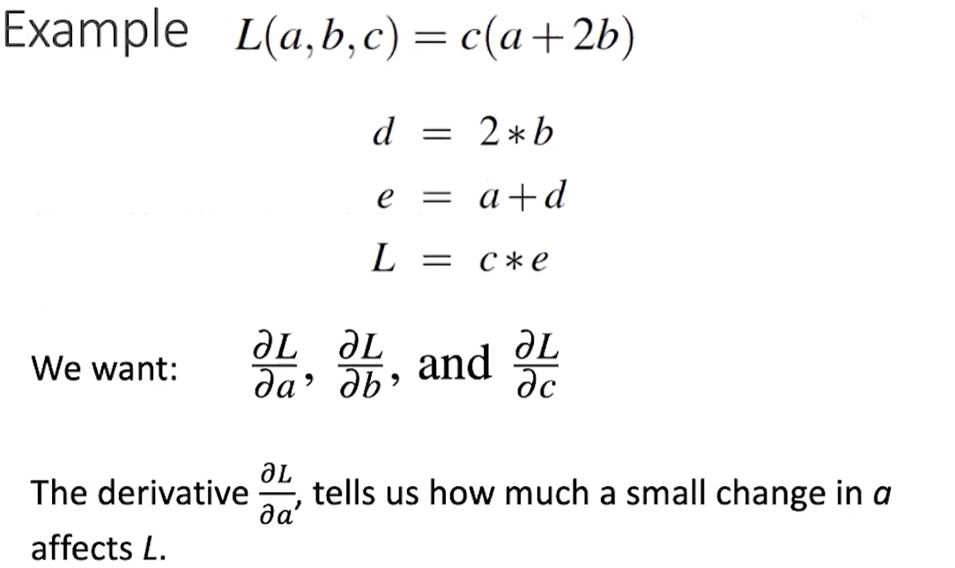
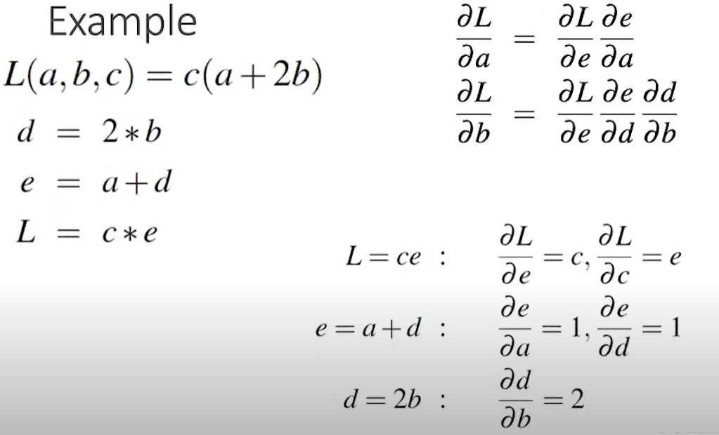
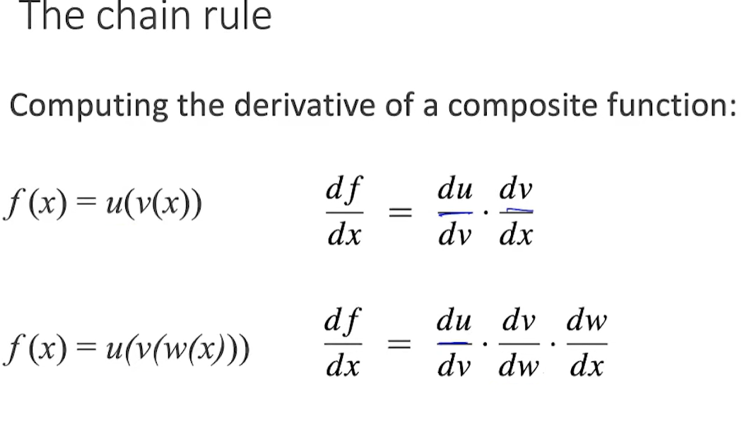

Slide 14
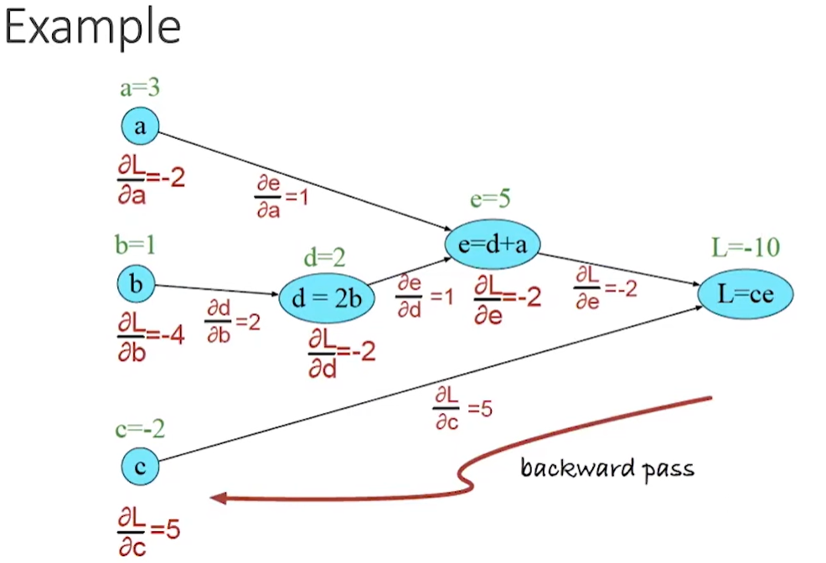

Slide 15
Key highlights

Slide 16
Feature | Description
🧠 Abstraction of Computation | Represents complex mathematical operations in graph form.
🔁 Directed Acyclic Graph (DAG) | No loops; ensures operations have a clear execution order.
🔗 Nodes | Represent operations like add, multiply, or matmul.
📦 Edges (Tensors) | Carry data (multi-dimensional arrays) between nodes.
🧩 Variables, Constants & Placeholders | Inputs to the graph. Variables can change, Constants cannot.
⚙️ Build Once, Run Many | Graph is defined once and can be executed multiple times with different inputs.
⚡ Optimized Execution | TensorFlow can optimize the graph for speed and memory before running.
🎯 Device Independence | Graph can be executed on CPU, GPU, or TPU seamlessly.
🔄 Lazy Evaluation (in TF 1.x) | Computation only happens when explicitly run in a session.
🚀 TF 2.x & Eager Execution | Uses eager execution by default but graphs can still be created using @tf.function.

Slide 17
Creating a Graph
Regression example
Gradient Descent

Slide 18
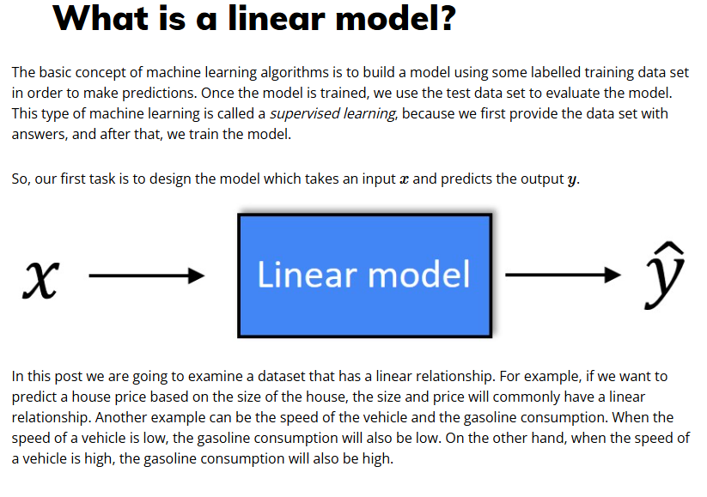
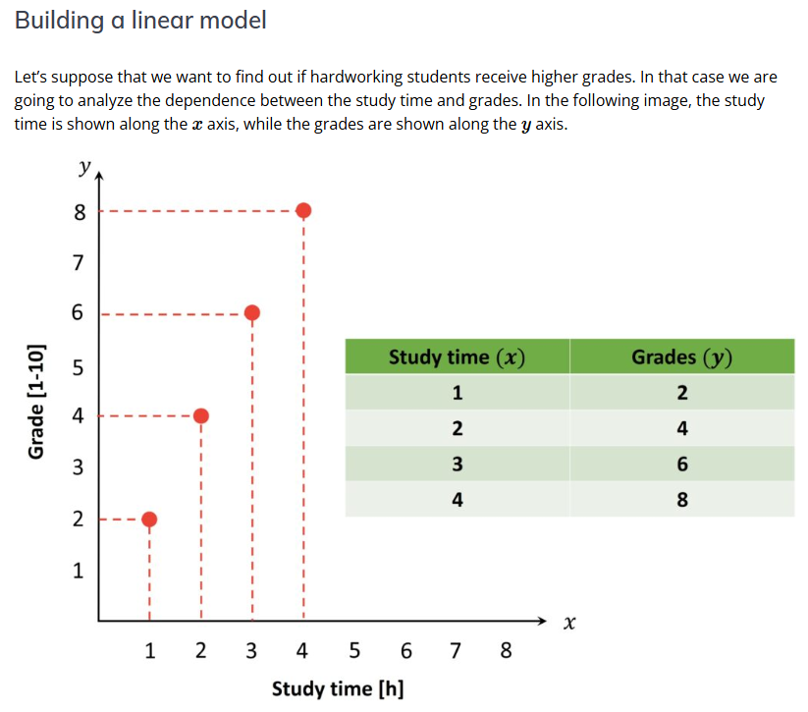

Slide 19

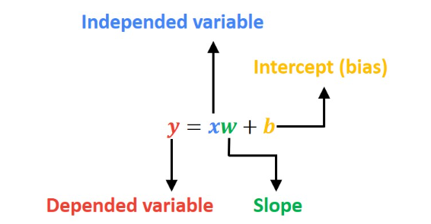
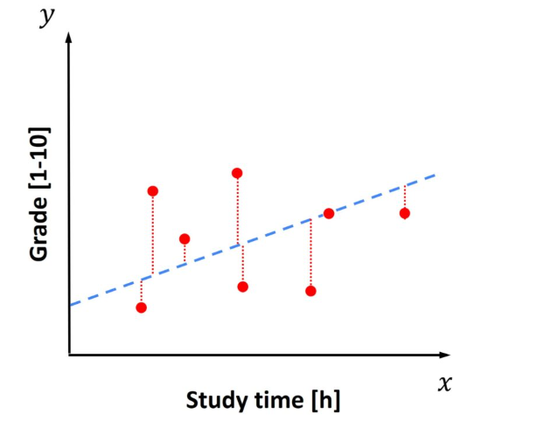
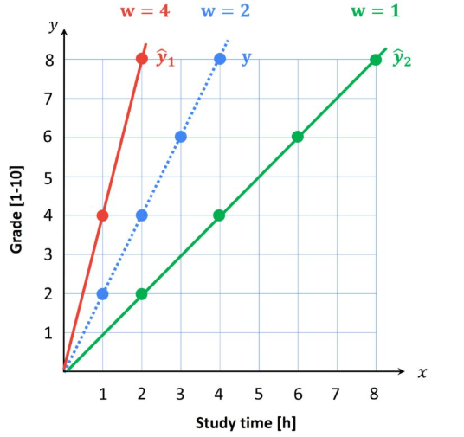
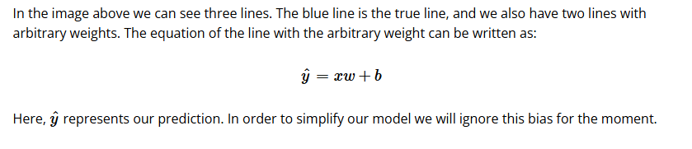
how study time affects grades?
Apply Linear regression in order to model the relationship between a dependent variables and independent variables.
To do that we can draw a line that best fits to our dataset.
In that way, we can predict where the future points may be and we can also identify outliers.
Problem:- We can’t draw the line because the parameters w and b are unknown to us.
Therefore, the main goal of our analysis is to determine the values for w and b.
First try to guess them

Slide 20
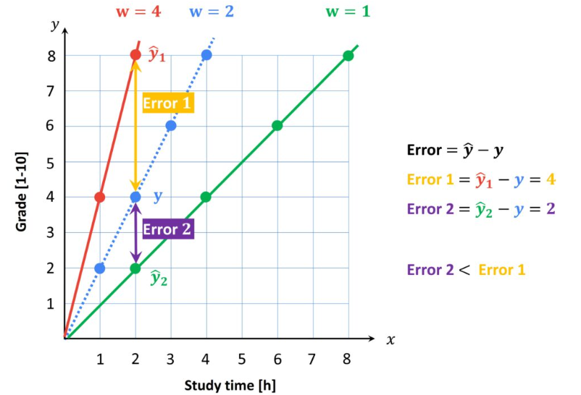

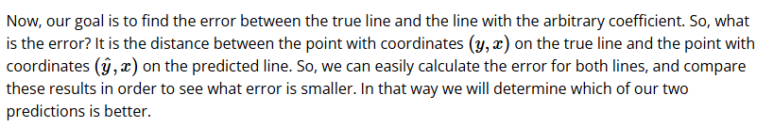
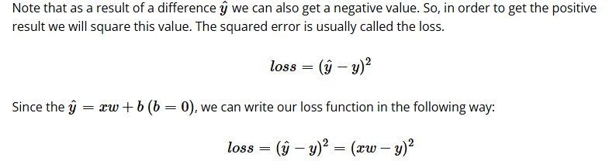
To see how the loss will change using different values of w. w=0, w=1, w=2, w=3 and w=4. Then, we have calculated the mean of the loss. In statistics, this operation is called Mean Squared Error (MSE) and it measures the average of the squares of the errors.

Slide 21
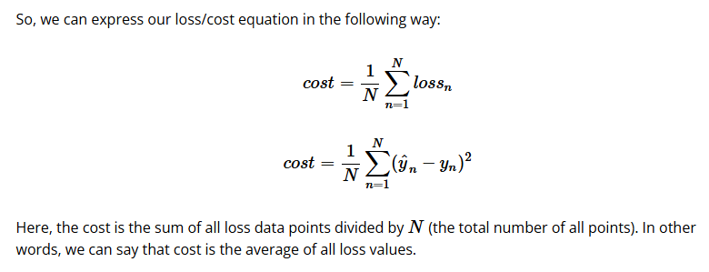
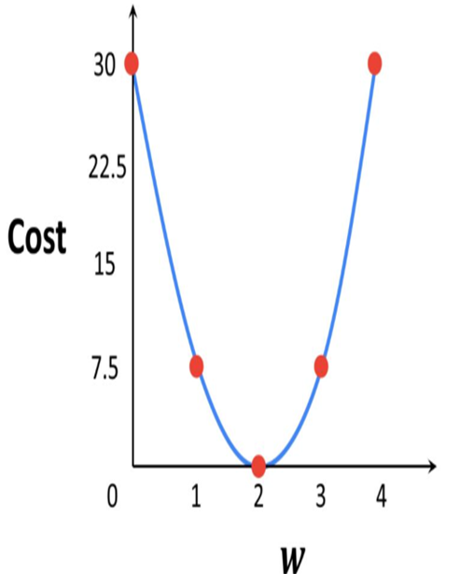
Therefor we require a algorithm is to minimize the cost function and to find optimal values for w and b.
solution:- Gradient Descent

Slide 22
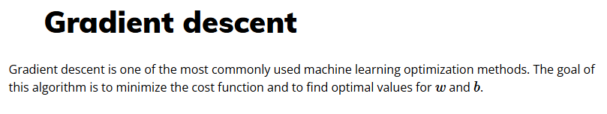
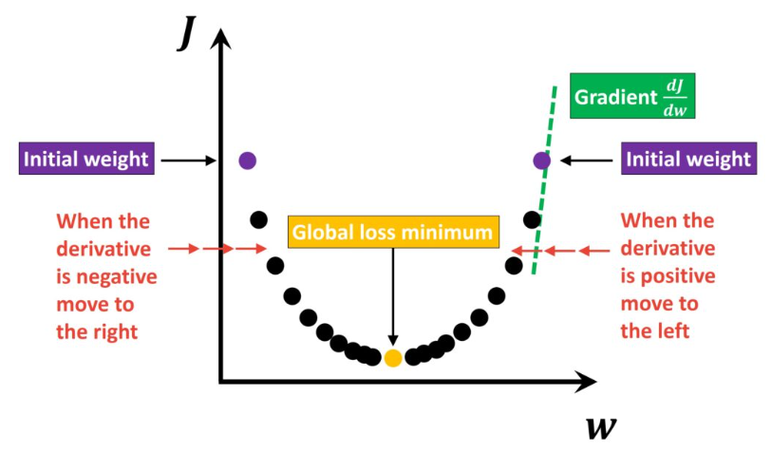

Slide 23
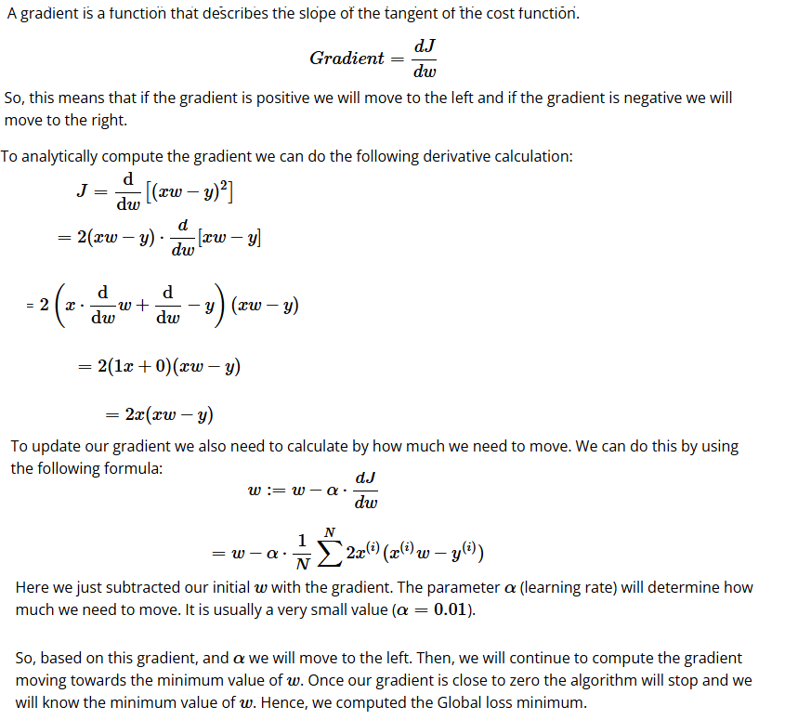

Slide 24
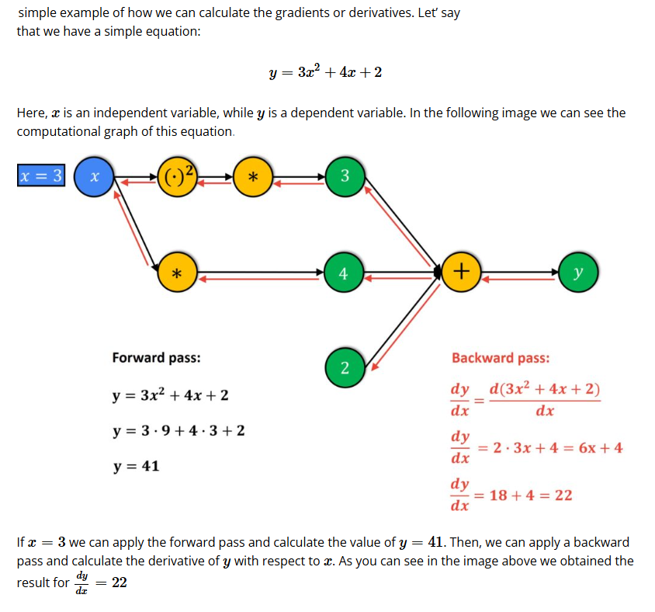

Slide 25
TensorBoard

Slide 26
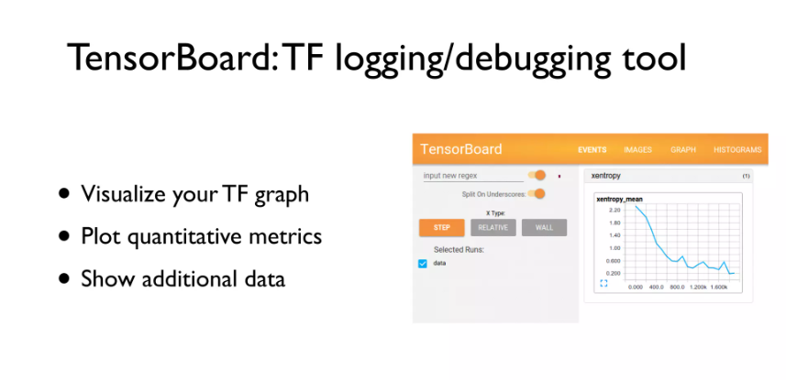
In machine learning, to improve something you often need to be able to measure it. TensorBoard is a tool for providing the measurements and visualizations needed during the machine learning workflow
TensorFlow used for model development
TensorBoard is used for monitoring & visualization.
TensorBoard enables tracking experiment metrics like loss and accuracy, visualizing the model graph, projecting embeddings to a lower dimensional space, and much more.
TensorBoard is specifically designed to work with TensorFlow, but can be adapted for other frameworks as well.

Slide 27
Tensorflow | Tensorboard
Open-source library and framework for building and training machine learning models (especially deep learning models). | Visualization toolkit bundled with TensorFlow for Monitoring, debugging, and understanding TensorFlow models during development and training.
- Supports various ML tasks - Enables scalable training on CPUs, GPUs, and TPUs - Utilizes data flow graphs - Offers APIs for multiple languages - Includes pre-built operations for common tasks | - Tracks and visualizes metrics like loss and accuracy - Visualizes the model graph - Displays histograms and distributions of tensors - Projects high-dimensional embeddings - Shows images, text, and audio data - Provides performance profiling
TensorFlow to create and run your machine learning models | TensorBoard to observe and analyze what's happening during the training process and within the model's structure.
TensorBoard is specifically designed to work with TensorFlow, but can be adapted for other frameworks as well

Slide 28
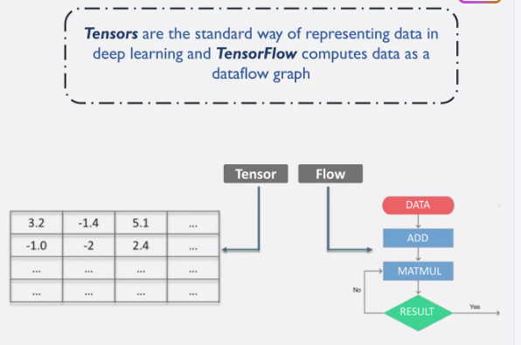
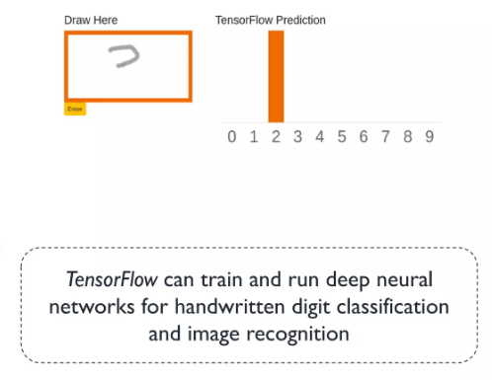
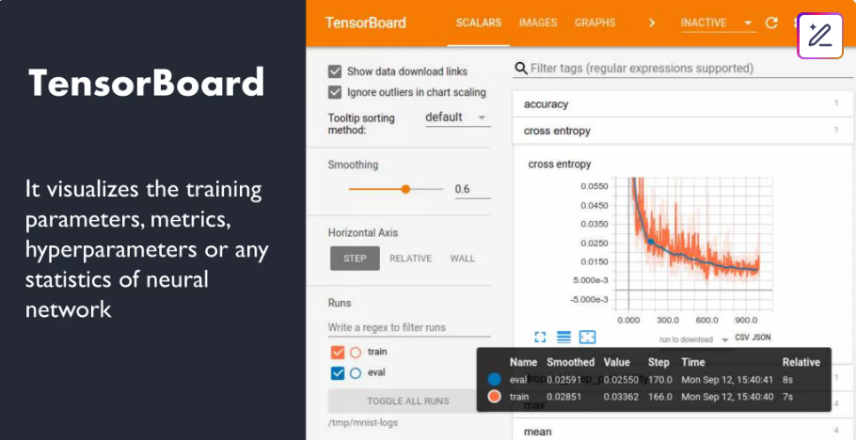

Slide 29
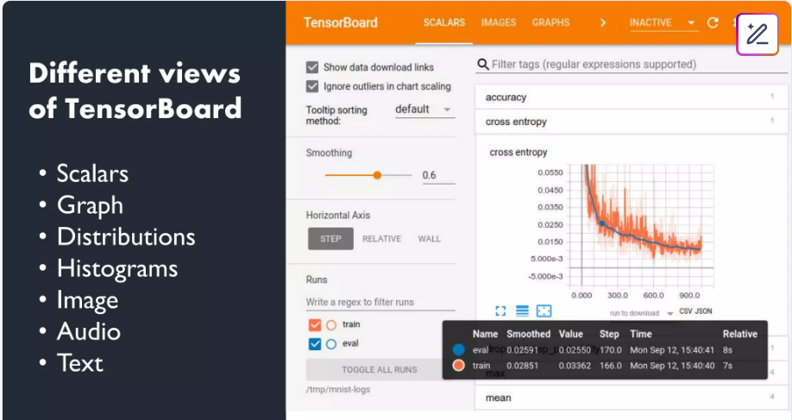

Slide 30
Modularity, Shared Variables

Slide 31
Modularity in neural networks involves structuring the network into distinct, interconnected sub-networks or modules, each potentially handling a specific aspect of the overall task
A single ANN is many times not able to give a good performance as per the problem and requirements. We hence may need more than one ANN to solve the same problem. This is done by the use of Modular Neural Network (MNN).
The term Modular Neural Network (MNN) is important because it represents a sophisticated approach to modeling complex problems through Artificial Intelligence (AI) and Machine Learning (ML).
MNNs comprise several independent and specialized neural network modules that work in unison to tackle specific sub-tasks.
Each of the ANN represents a module and is responsible for solving some part of the problem.
Hence the complete system may be said to have two parts that work in a master slave mode. The first consists of an integrator that divides the problem and gives it to the various modules. Later this collects the responses of the individual modules and computes the final output of the system. The other part is the modules, each of which is an ANN.

Slide 32
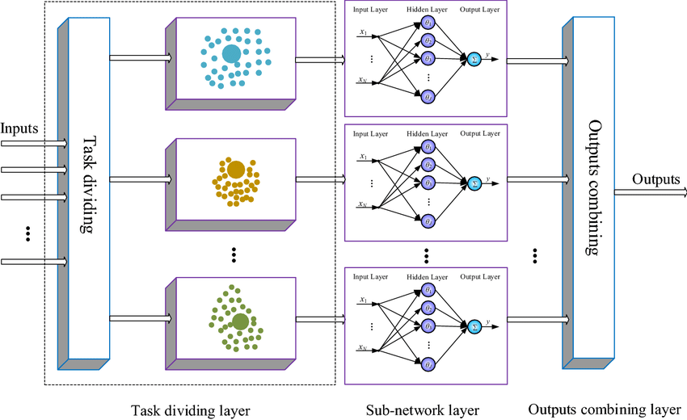
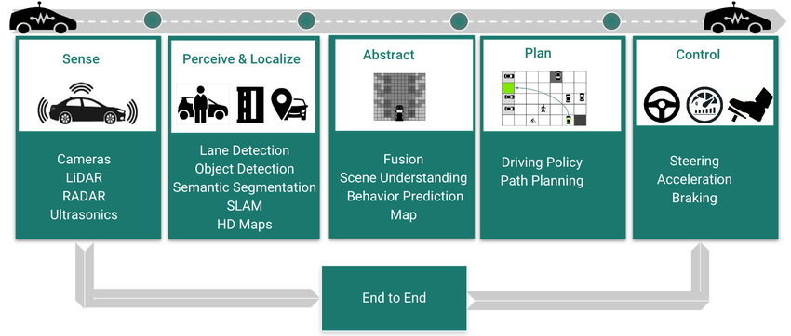
Example:- Perception, navigation, decision in autonomous vehicle

Slide 33
Applcations of MNN
1. Computer Vision
Modules specialized in edge detection, feature extraction, object classification, etc.
Combined in a modular ensemble for tasks like image segmentation, facial recognition, or medical imaging analysis.
2. Natural Language Processing (NLP)
Different modules for syntax parsing, semantic encoding, sentiment detection, translation.
These modular sub-networks can be individually trained or fine-tuned and then stitched into a multitask NLP pipeline.
3. Robotics & Autonomous Agents
Modules for perception, path planning, motor control, decision making.
E.g. one module handles sensor fusion, another handles trajectory generation— all coordinated at runtime.
4. Healthcare & Medical Diagnosis
Modular networks analyze diagnostic imaging, patient history, symptom profiles separately.
Each module outputs disease predictions or treatment suggestions before integration.
5. Financial Analysis & Fraud Detection
Modules for time-series forecasting, risk modeling, anomaly detection.
Each subnetwork processes different aspects of financial data and combines outputs for decisions.

Slide 34
ADVANTAGES of MNN
1. Parallel sub‑task training | Each module (block) can be trained independently
2. Specialization | Modules specialize in designated subtasks
3. Reusability | Same module reused across different applications
4. Scalability & maintenance | Nodes or feeds can be added or replaced easily
5. Robustness & fault isolation | Failure of one module doesn't collapse whole system

Slide 35
Sharing Variables
Parameter sharing means using the same weights (and biases) across different parts of a neural network—such as different tasks, time steps, layers, or modules. This reuses parameters, rather than creating separate copies—cutting down on memory, improving efficiency, and often generalizing better
Layer and Parameter Sharing techniques are powerful strategies used to reduce the size and computational complexity of machine learning models, particularly large neural networks like language models. These methods work by reusing the same parameters or layers across different parts of the model, effectively decreasing the total number of unique parameters that need to be stored and computed.
This approach not only reduces memory usage but also enhances computational efficiency, making it particularly valuable for resource-constrained environments.
In the context of neural networks, shared variables refer to parameters, typically weights and biases, that are used by multiple layers or units within a network. This concept is crucial for reducing the number of parameters to be learned, thereby decreasing computational cost and improving efficiency, especially in architectures like convolutional neural networks (CNNs) and recurrent neural networks (RNNs).

Slide 36
Instead of having unique sets of weights for each layer or unit, shared variables allow multiple parts of the network to use the same set of parameters.This means that the same set of weights or biases is applied to different parts of the input data, effectively creating multiple instances of the same transformation.
For instance, in a CNN, the same convolutional filter is applied to different locations in the input image using shared weights.
Advantages:-
Reduced Model Complexity:
By sharing parameters, the number of parameters to be learned is significantly reduced, leading to smaller and more efficient models.
Increased Generalization:
Shared variables can improve a model's ability to generalize to unseen data by learning more robust features that are not tied to specific locations in the input.
Improved Efficiency:
Training a model with shared variables is faster and requires less memory compared to a model with unique parameters for each layer or unit.
Feature Invariance:
In CNNs, shared weights make the network invariant to the location of features in the input image.

Slide 37
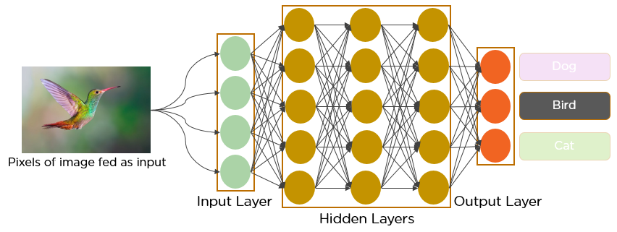
When classifying images, traditional neural networks struggle because each pixel is treated as an independent feature, which misses critical patterns in how pixels, interact.
Suppose we start with an image that’s 224 x 224 pixels with 3 color channels (RGB). If we fed it directly to a neural network without convolution, we’d need 224 x 224 x 3 = 150,528 neurons in the input layer.
But with a CNN, we can apply several convolutional filters that gradually reduce the size of the image’s data, capturing only the essential features. By the time the image has passed through multiple convolutional layers, its data might be reduced to just 1 x 1 x 1000. This final representation only needs 1000 neurons in the next layer, instead of 150,528.

Slide 38
Keras : Perceptron

Slide 39
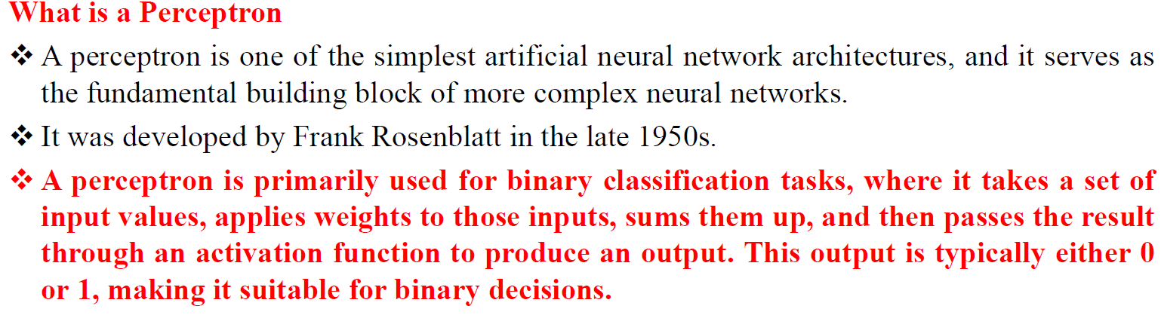
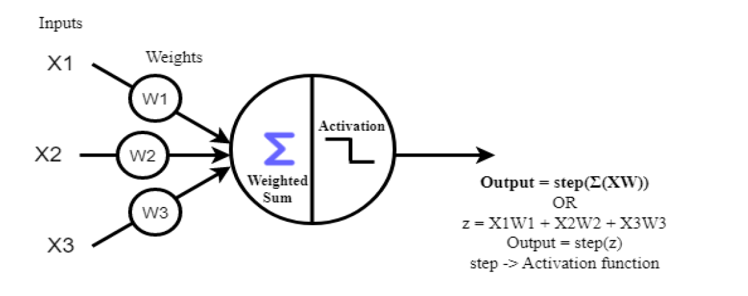

Slide 40
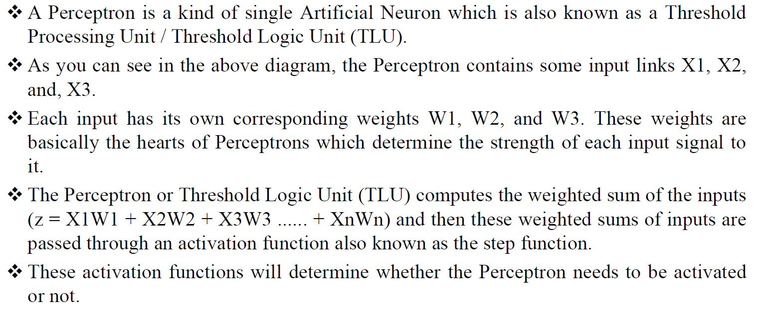

Slide 41
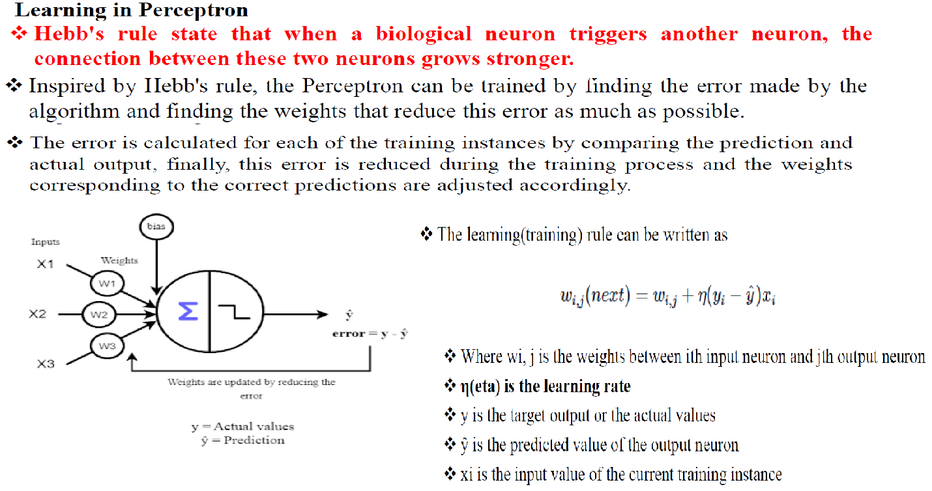

Slide 42
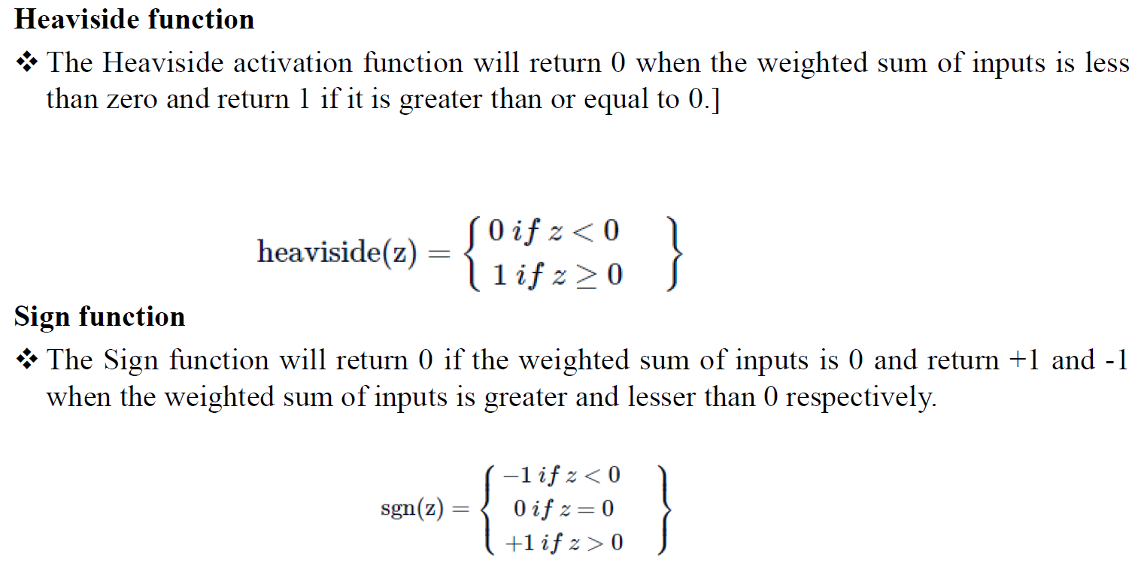

Slide 43
Perceptron XOR Gate

Slide 44
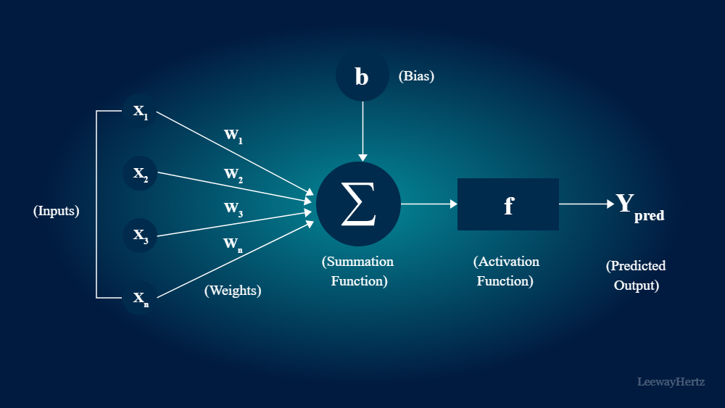
A neural network architecture represents the structure and organization of an artificial neural network (ANN), which is a computational model inspired by the workings of a biological neural network.
The architecture explains how data flows through the network, how neurons (units) are connected, and how the network learns and makes predictions.
Here are the key components of a neural network architecture.
Layers: Neural networks consist of layers of neurons,
which include the input layers, hidden layers, and
output layers.
2. Neurons (Nodes): Neurons are the basic computational
units that perform a weighted sum of their inputs,
apply a bias, and pass the result through an
activation function.
3. Weights and biases: Weights represent the strength of
the connections between neurons, and biases
allow neurons to make predictions even when
all inputs are zero.
4. Activation function: Non-linear functions (like ReLU
and Sigmoid) are used to introduce non-linearity
into the network, enabling it to model complex relationships.

Slide 45
The neural network architecture defines its capabilities.
1. Model’s capacity
A model with high depth (number of layers) and width (number of neurons in each layer) can handle complex relationships. A network with few layers cannot handle tasks like image or speech recognition.
2. Efficiency
The neural network’s architecture affects the efficiency of the model. For instance, convolutional neural networks (CNNs) have lower computational costs compared to fully connected networks.
3. Optimization
The network’s structure affects its optimization. For instance, deeper networks may face issues like vanishing gradients, where the gradients become too small for effective learning in early layers.
4. Task-specific design
The architecture of networks can be tailored to specific tasks, such as CNNs for image classification and RNNs for sequence prediction.

Slide 46
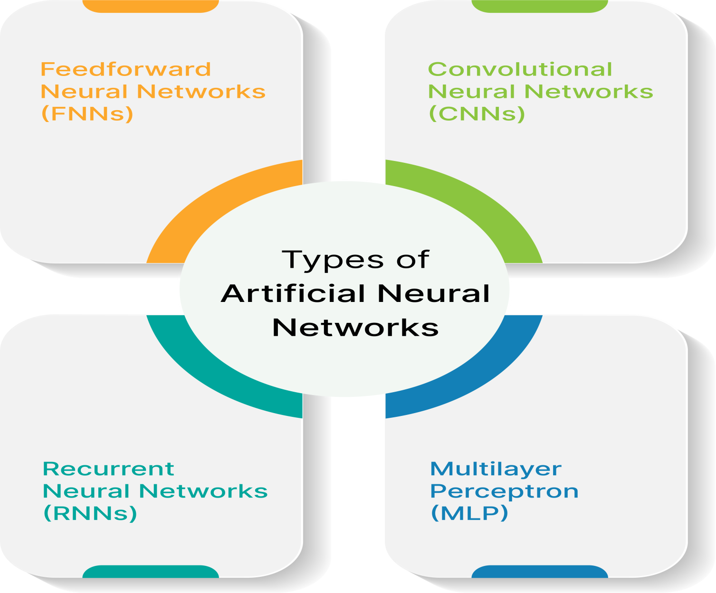
FNN:- It consists of input, hidden, and output layers but lacks feedback loops. It is well-suited for many applications because of its straightforward structure, including regression and pattern recognition.
CNN:- is an artificial neural network algorithm specially designed for image processing.
RNN:- A recurrent neural network (RNN) is a type of artificial neural network designed for processing sequences of data.
MLP:- is a type of feedforward neural network with three or more layers, including an input layer, one or more hidden layers, and an output layer. It uses nonlinear activation functions.

Slide 47
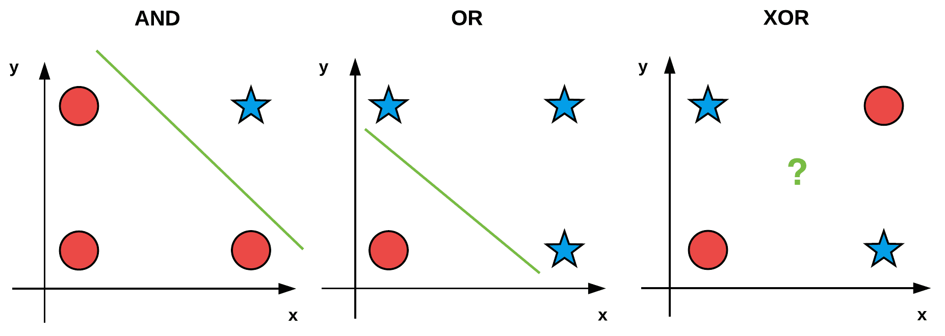
The Perceptron is a type of Feedforward Neural Network (FNN) — specifically, it's the simplest form of a neural network.
A Perceptron is a single-layer neural network used primarily for binary classification problems.
i.e, the basic perceptron can only solve linearly separable problems (like AND, OR).
It cannot solve non-linear problems like XOR.
A Multi-Layer Perceptron (MLP) can solve non-linear problems using hidden layers and non-linear activations.

Slide 48
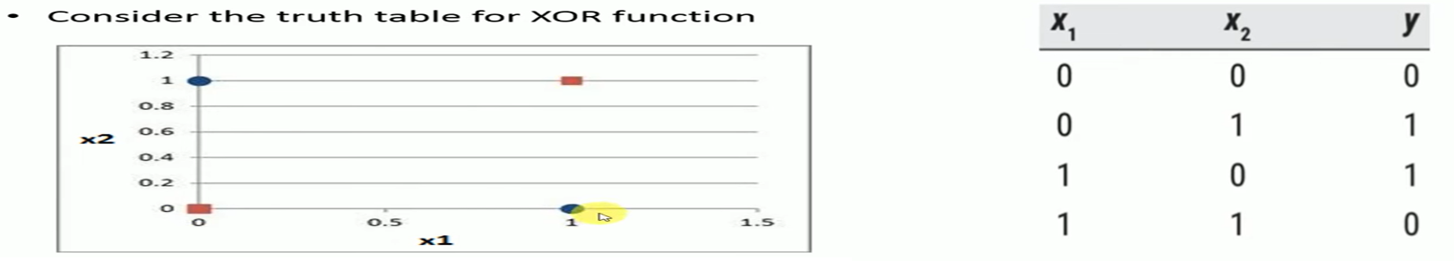
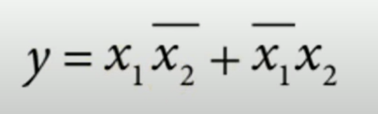
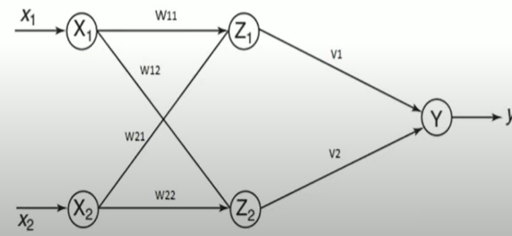
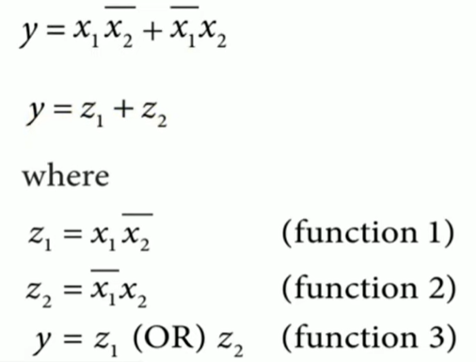
As XOR is non linear,it is not possible to draw a single line for given data differentiate the category of points, so to solve this problem following equation is used (perceptron rule for XOR)

Slide 49
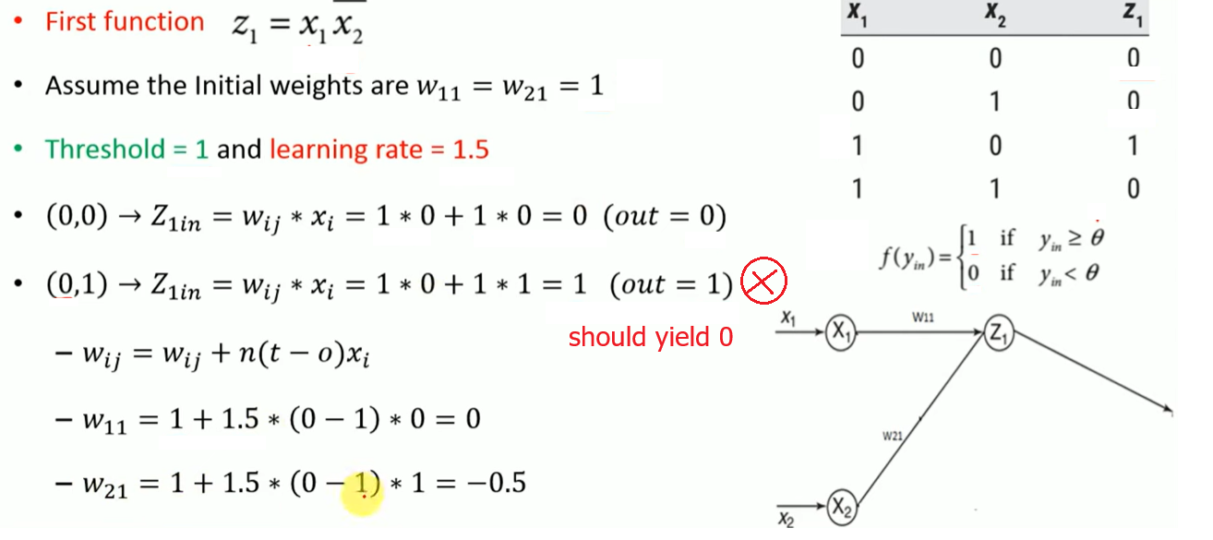

Slide 50
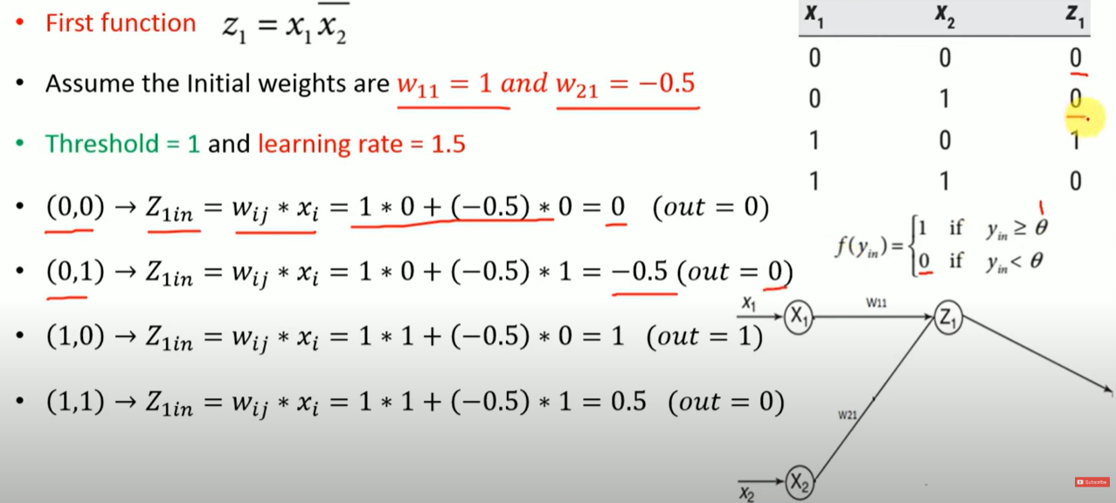

Slide 51
Activation Functions:
Sigmoid, ReLU, Hyperbolic Fns, Softmax

Slide 52
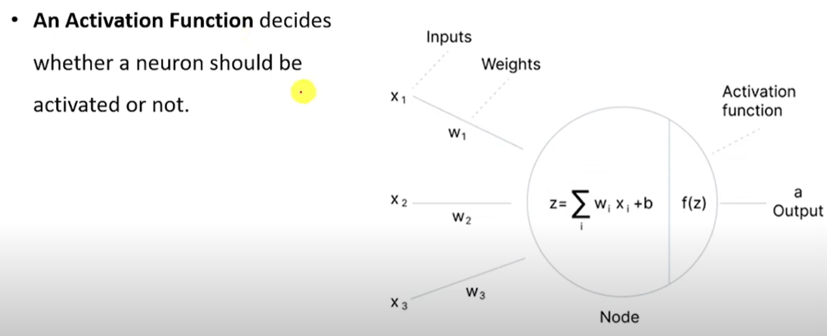


Binary step Function
Linear ActivationFunction
Non Linear Activation Function

Slide 53



1. Binary step Function:- If the weighted sum of present neuron is less than zero, neuron is activated is greater or equal to zero, neuron is not activated Disadv:- ->Cannot provide multi-value output ->As Gradient is zero for Binary step function, backpropagation is not possible. | 2. Linear Activation/ No Activation/ Identity Function:- Whatever weighted sum is there in present neuron will be transferred to next neuron. Disadv:- ->Backpropagation is not possible ->cannot support multi layer Neural Networks
3. Non Linear Activation Function:- Adv:- -> Allows backpropagation -> Allows multi-layer neural networks
Types

Slide 54


DisAdv:-
Low gradient →low learning rate

Slide 55


DisAdv:-

Slide 56



Adv:-
DisAdv:-

Slide 57


Adv:-
DisAdv:-

Slide 58


Adv:-
DisAdv:-

Slide 59


Slide 60


